Slide 1
ADO.NET
A Brief :
ADO.NET provides a bridge between the front end controls and the back end database. The ADO.NET objects encapsulate all the data access operations and the controls interact with these objects to display data, thus hiding the details of movement of data.

Slide 2
What is ADO.NET?
ADO stands for ActiveX Data Objects
ADO.NET is a database technology of .NET Framework used to connect application system and database server.
ADO.NET is a part of the .NET Framework
ADO.NET consists of a set of classes used to handle data access
ADO.NET uses XML to store and transfer data among applications, which is not only an industry standard but also provide fast access of data for desktop and distributed applications.
ADO.NET is scalable and interoperable.

Slide 3
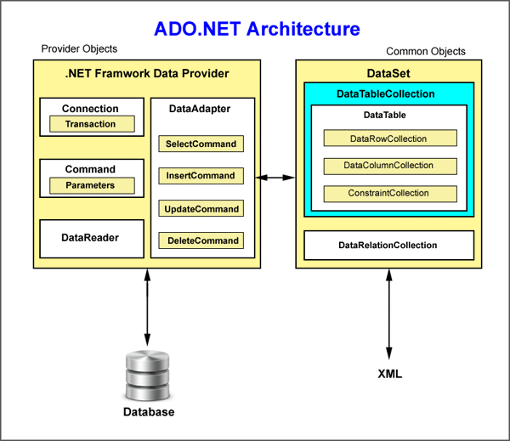

Slide 4
Advantages of ADO.Net
Single Object-oriented API
ADO.NET provides a single object-oriented set of classes. There are different data providers to work with different data sources but the programming
model for all these data providers work in the same way. You should be aware of only one data provider. You just need to change class names and connection strings.
The ADO.NET classes are easy to use and understand, as they are object-oriented in nature.
Managed Code
The ADO.NET classes are managed classes. CLR takes care of language independency and automatic resource management.

Slide 5
Deployment
Microsoft uses MDAC (Microsoft Data Access Component), which is used as ActiveX component in .NET Framework (X is extensible component, when X is written
after a term means extensible). .NET components takes care of deployment which was difficult previous technologies used in deployment.
XML Support
ADO.NET data is cached and transferred in XML (EXtensible Markup Language) format. XML provide fast access of data for desktop and distributed applications.
XML is plain text designed to transport and store data and is self-descriptive.

Slide 6
Visual Data Components
.NET offers ADO.NET components and data-bound control to work in visual form. You can use these components without writing long codes and can achieve result in no time.
Performance and scalability
Performance and scalability are two major factors when developing web-based application and services. Disconnected cached data in XML help in performance and scalability.

Slide 7
Various Connection Architectures
There are the following two types of connection architectures:
Connected architecture: the application remains connected with the database throughout the processing.
Disconnected architecture: the application automatically connects/disconnects during the processing. The application uses temporary data on the application side called a DataSet.

Slide 8
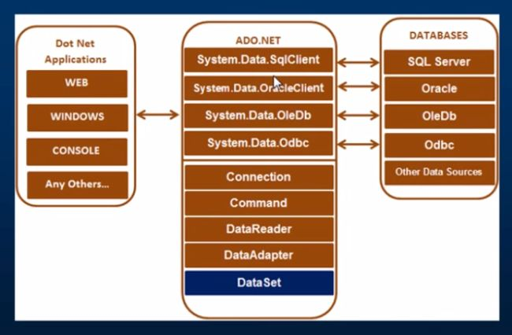
Understanding ADO.NET and its class library

Slide 9
Important Classes in ADO.NET
Connection Class
Command Class
DataReader Class
DataAdapter Class
DataSet.Class

Slide 10
Classes in ADO.Net
Connection Class In ADO.NET, we use these connection classes to connect to the database. These connection classes also manage transactions and connection pooling. 2. Command Class The Command class provides methods for storing and executing SQL statements and Stored Procedures. The following are the various commands that are executed by the Command Class.
ExecuteReader: Returns data to the client as rows. This would typically be an SQL select statement or a Stored Procedure that contains one or more select statements. This method returns a DataReader object that can be used to fill a DataTable object or used directly for printing reports and so forth.
ExecuteNonQuery: Executes a command that changes the data in the database, such as an update, delete, or insert statement, or a Stored Procedure that contains one or more of these statements. This method returns an integer that is the number of rows affected by the query.

Slide 11
Classes in ADO.Net contd..
DataReader Class The DataReader is used to retrieve data. It is used in conjunction with the Command class to execute an SQL Select statement and then access the returned rows. 4. DataAdapter Class The DataAdapter is used to connect DataSets to databases. The DataAdapter is most useful when using data-bound controls in Windows Forms, but it can also be used to provide an easy way to manage the connection between your application and the underlying database tables, views and Stored Procedures.

Slide 12
Classes in ADO.Net contd..
DataSet Class
The DataSet is the heart of ADO.NET. The DataSet is essentially a collection of DataTable objects. In turn each object contains a collection of DataColumn and DataRow objects. The DataSet also contains a Relations collection that can be used to define relations among Data Table Objects.

Slide 13
DbCommand and DbConnection Objects
The DbConnection object represents a connection to the data source. The connection could be shared among different command objects.
The DbCommand object represents the command or a stored procedure sent to the database for retrieving or manipulating data.

Slide 14
To Connect to the Database
A connection string is required as a parameter to SQLConnection. A ConnectionString is a string variable (not case sensitive). This contains key and value pairs, like provider, server, database, userid and password as in the following:
Server="nameof the server or IP Address of the server" Database="name of the database" userid="user name who has permission to work with database" Password="the word of userid“
Example : SQL Authentication String constr="server=.;database=institute;user id=newuser123#;word=password"; Or: String constr="data source=.;initial catalog=institute;uid=newuser123#;pwd=password";

Slide 15
Windows Authentication String constr="server=.;database=institute;trusted_connection=true" Or: String constr="server=.;initial catalog=institute;integrated security=true"

Slide 16
Retrieve and display data from a database
Procedure:
You must use the System.Data.SqlClient namespace
Create a SqlConnection object using a connection string.
Handle exceptions.
Open the connection.
Create a SQLCommand. To represent a SQLCommand . Specify the type of SQLCommand (text/storedprocedure).
Execute the command (use executereader).
Get the Result (use SqlDataReader). This is a forwardonly/readonly dataobject.
Close the connection
Process the result
Display the Result

